Slide 1


Slide 2
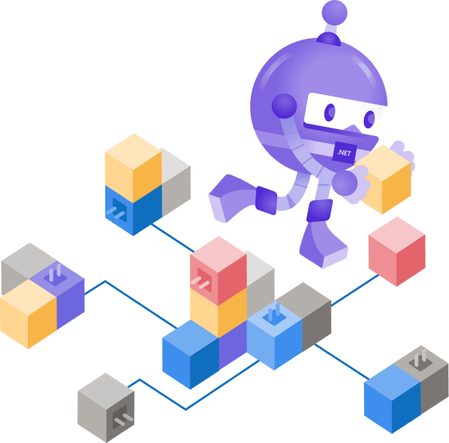
High-performance Services with gRPC
Hung Nguyen

Slide 3

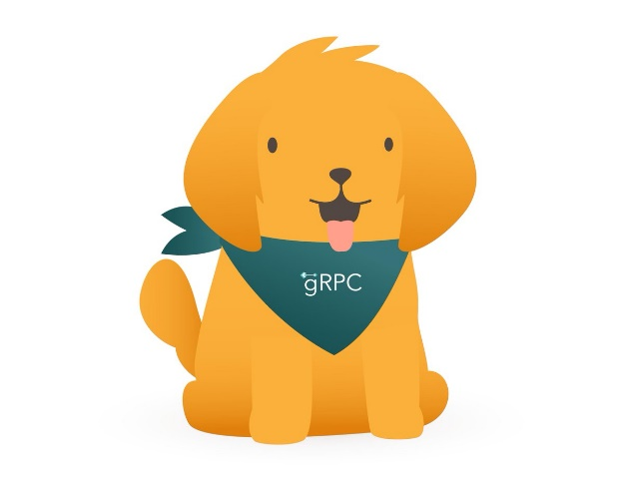
Outline
What is gRPC?
What are Protocol Buffers?
gRPC API Types
REST vs gRPC
How gRPC Work?
Creating gRPC Service
Building gRPC Client
gRPC & .NET 5
Resources

Slide 4
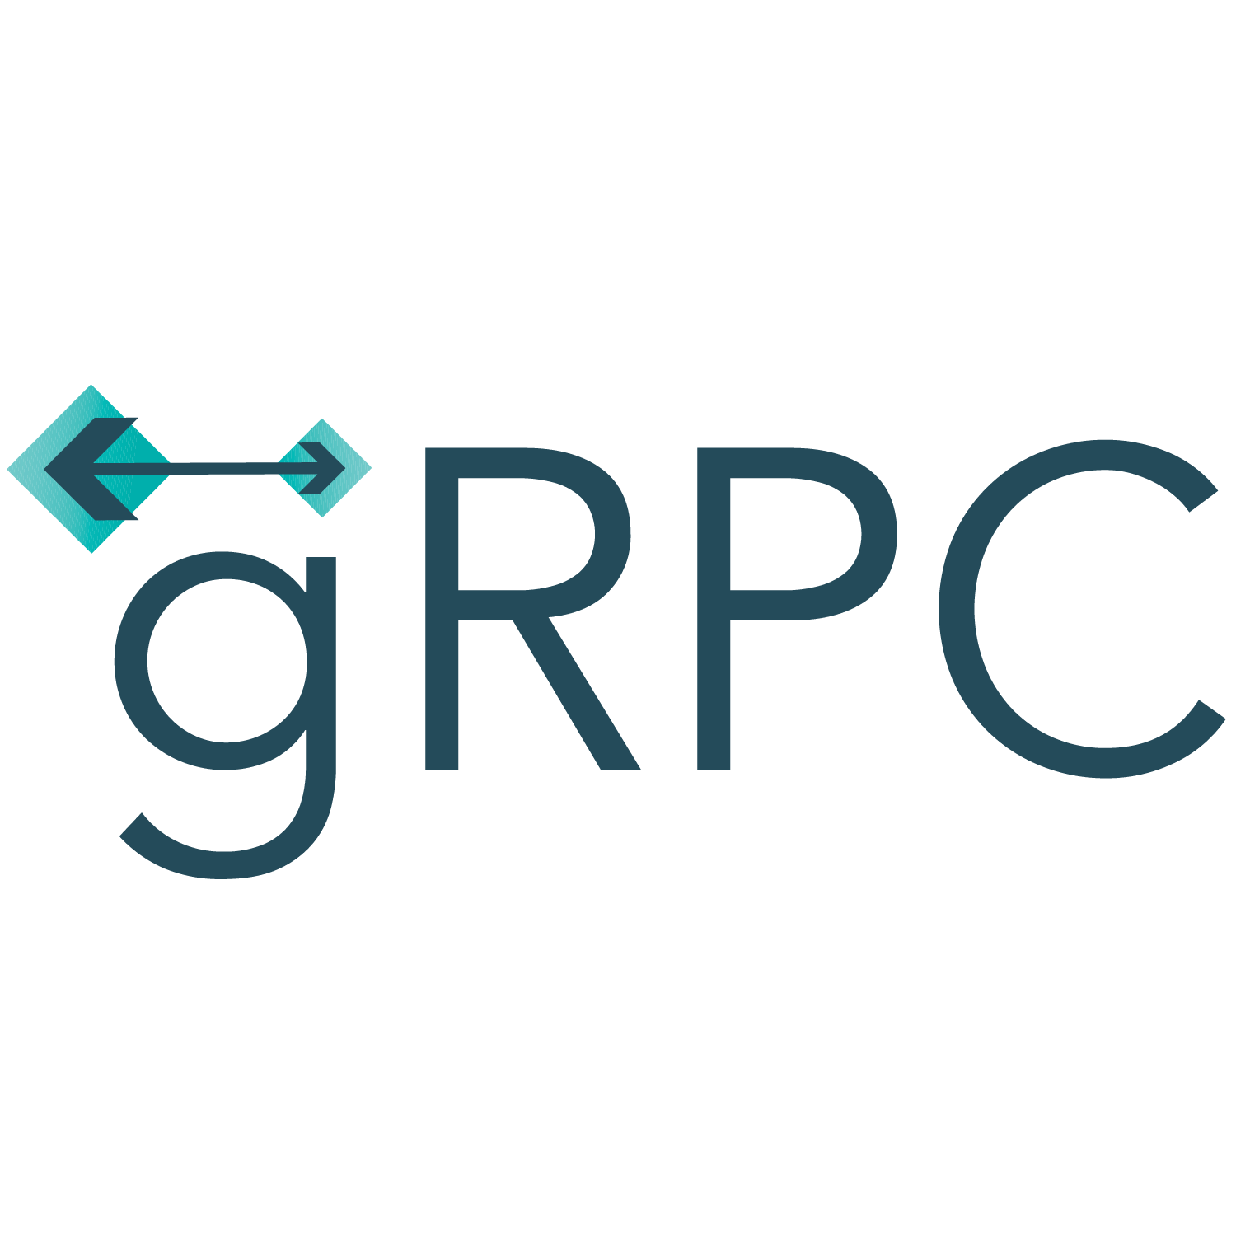
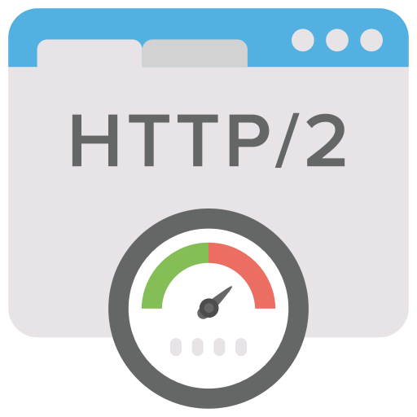

What is gRPC?
gRPC = general-purpose Remote Procedure Calls
High Performance RPC framework
HTTP/2-based transport
Project supported by the Cloud Native Computing Foundation (CNCF)
+
=

Slide 5
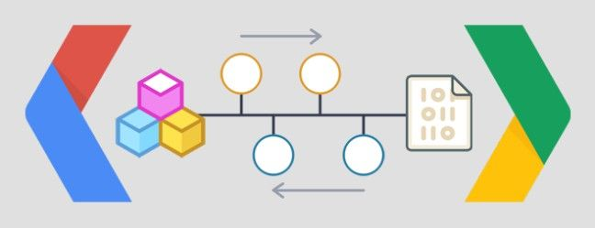
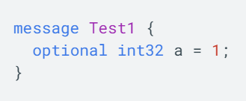

What are Protocol Buffers?
Way to serialize data
Somewhat like JSON Serialization but much simpler, compact and faster
IDL (Interface Definition Language)
Describe once and generate interfaces for any language
Service model
Service method and structure of the request and the response
Wire format
Binary format for network transmission

Slide 6
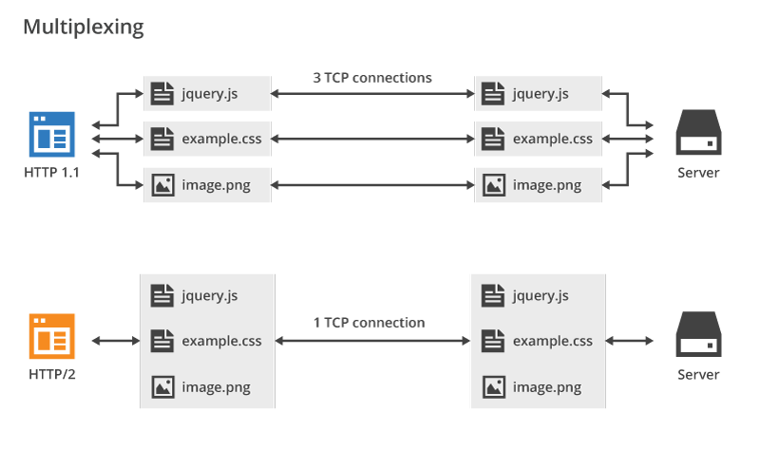
HTTP/2 vs HTTP/1.1
Notes:
Duplex streaming
Multiplexing
Compact binary + headers compression
Channel security with TLS

Slide 7
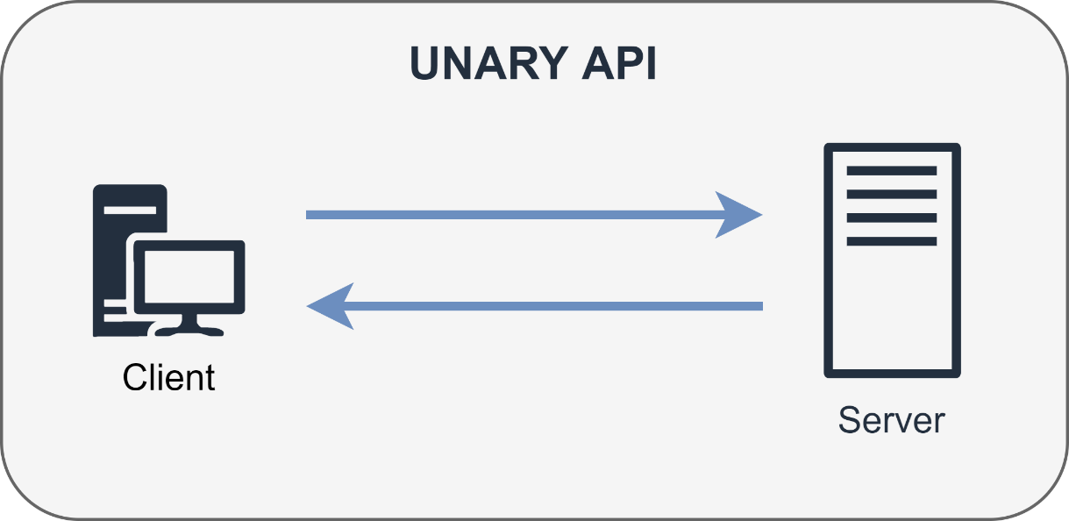
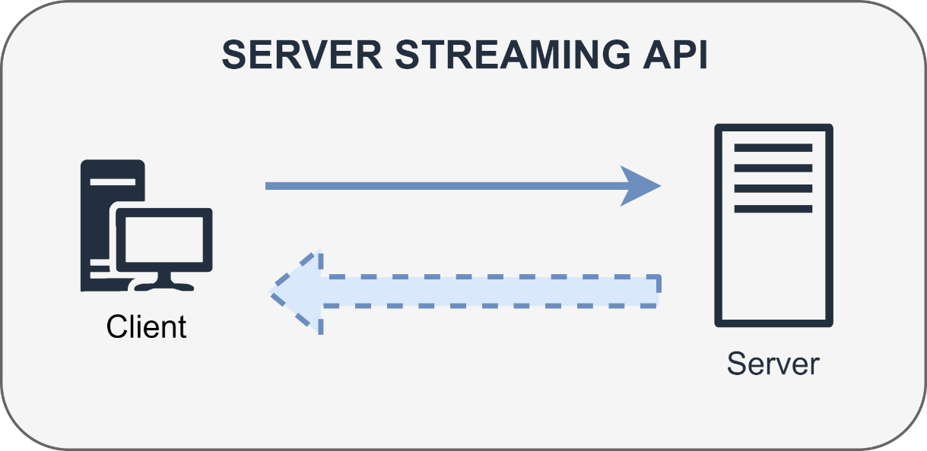
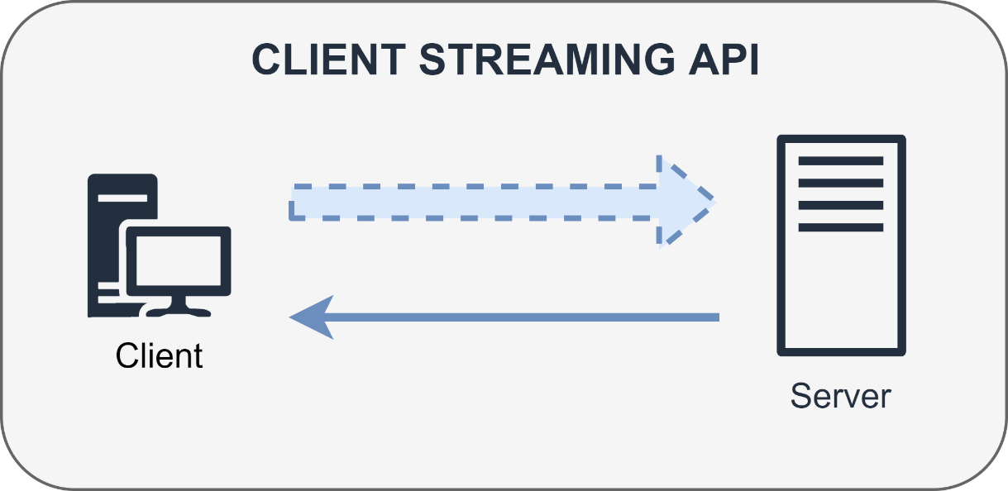
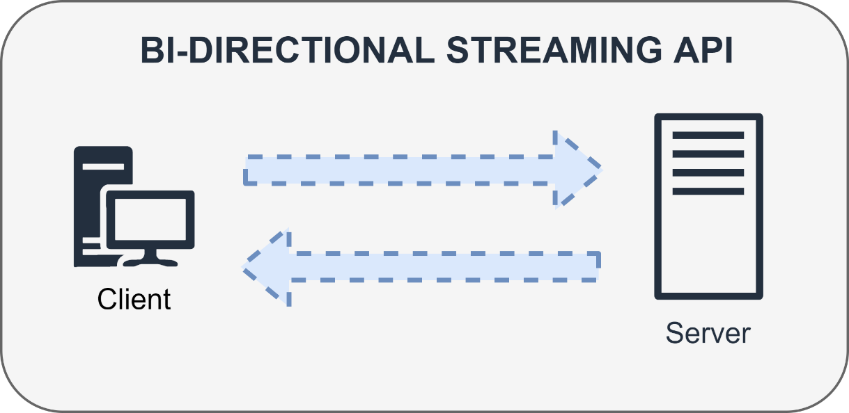
gRPC API Types
Notes:
gRPC supports the following communication patterns.
Unary RPC: The client sends a single request and the server sends back a single response.
Server streaming RPC: The client sends a single request and the server sends back a stream of responses.
Client streaming RPC: The client sends a stream of messages to the server and the server sends back a single response.
Bi-directional streaming RPC: The client sends a stream of messages to the server and the server sends back a stream of responses.

Slide 8
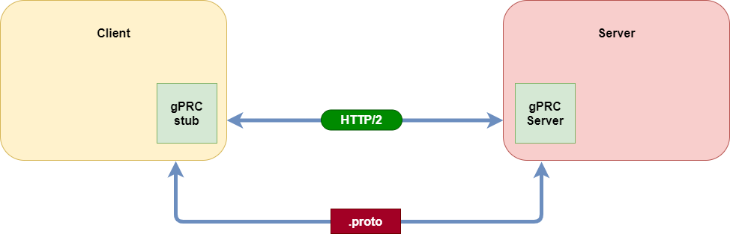
How gRPC Work?
Architecture of basic gRPC-based system

Slide 9
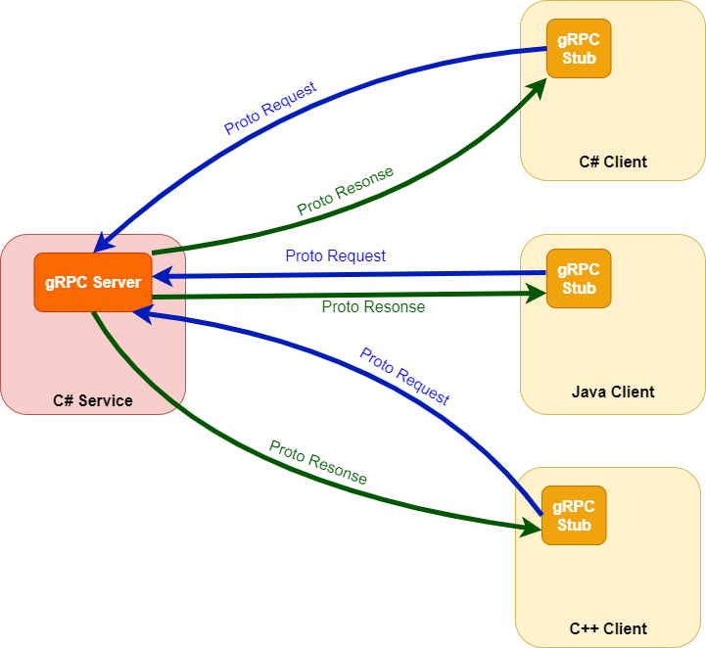
How gRPC Work?

Slide 10
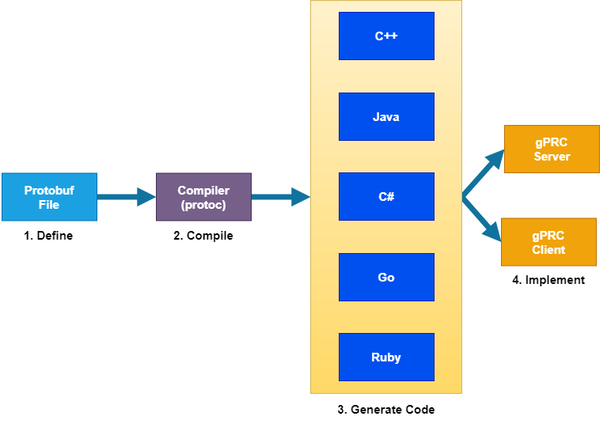
gRPC Workflow

Slide 11
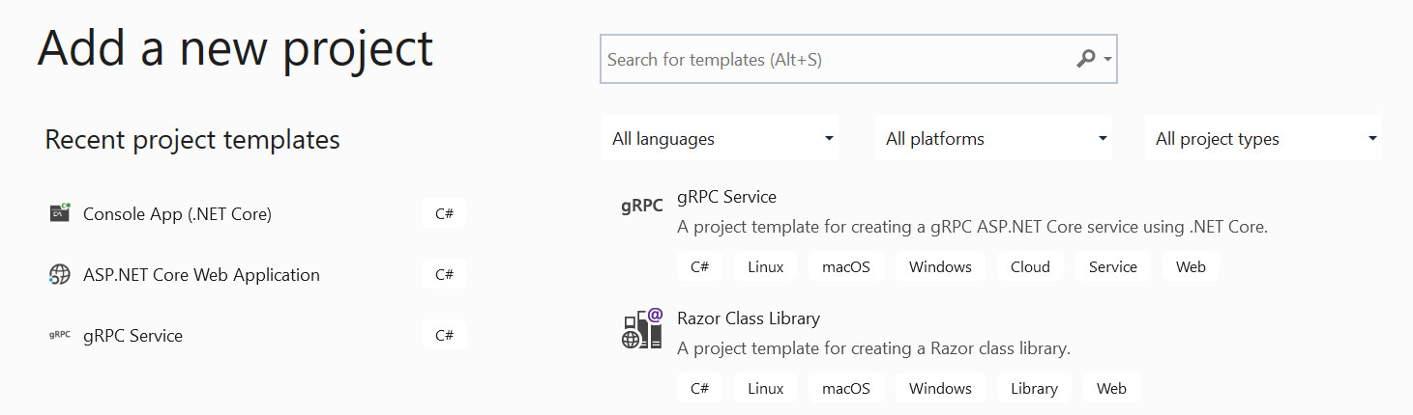
Creating a gRPC Service
Let’s create a gRPC service in Visual Studio
gRPC template for building gRPC services

Slide 12
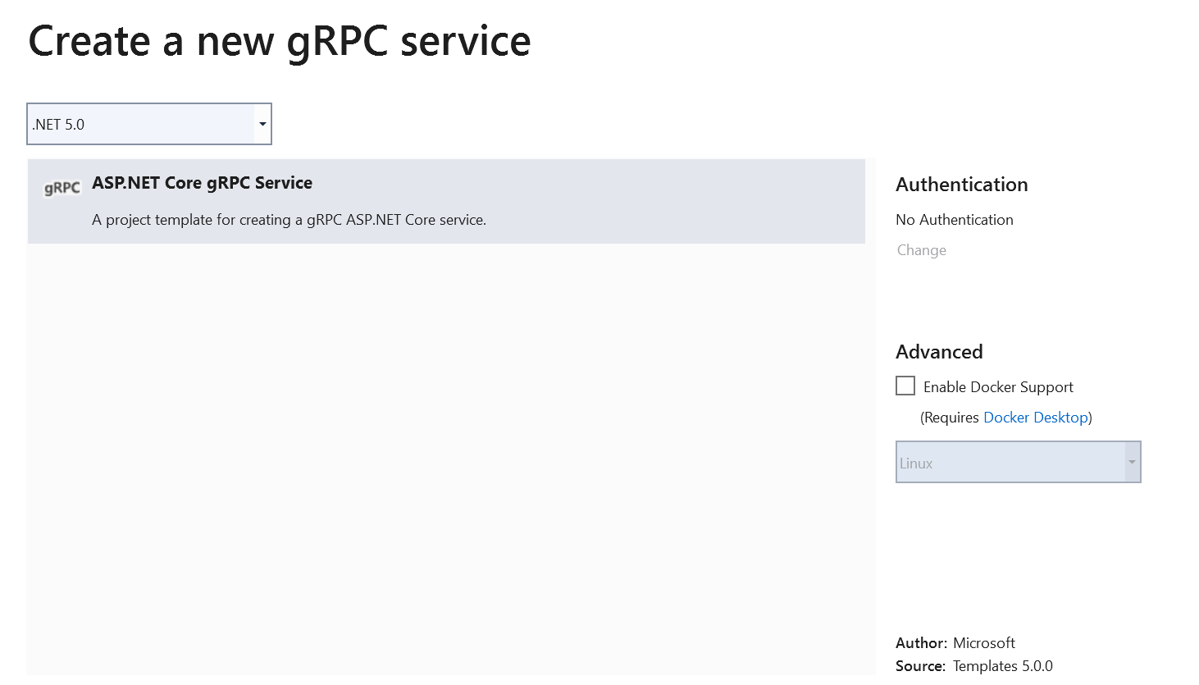
Creating a gRPC Service
Notes:
First start the Visual Studio and select Create a new project.
In Create a new project dialog, select gRPC Service and select Next.
Name you GrpcService project .

Slide 13
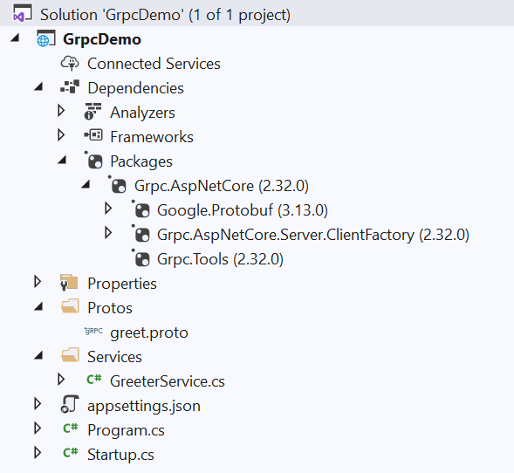
gRPC Service Project Structure
gPRC Nuget Packages
Folder contains .proto files used to define contracts and messages
Folder contains strongly type service class(es)
Notes:
Once the project is created examine the different project files, these are:
greet.proto – This file is created inside Protos folder. It is protobuf file that defines the contract (like models, methods) exposed by this service. Protobuf is just a serialization/deserialization tool like JSON but up to 6 times faster than JSON.
GreeterService.cs – This file is created inside Services folder and contains the implementation of gRPC service.
appsettings.json – Contains configuration data, such as protocol used by Kestrel.
Program.cs – Contains the entry point for the gRPC service.
Startup.cs – Contains code that configures app behavior

Slide 14
gRPC .proto file
syntax = "proto3";
option csharp_namespace = "GrpcDemo";
package greet;
// The greeting service definition.
service Greeter {
// Sends a greeting
rpc SayHello (HelloRequest) returns (HelloReply);
}
// The request message containing the user's name.
message HelloRequest {
string name = 1;
}
// The response message containing the greetings.
message HelloReply {
string message = 1;
}
Define which syntax version to use
Specifies namespace going to be used for this proto
Defines name of proto package
Defines supported services of this proto file
Specifies a rpc Service with name SayHello that takes in a ‘Message’ object named HelloRequest and responds with HelloReply
Messages

Slide 15
gRPC Service Implementation
using Grpc.Core;
using Microsoft.Extensions.Logging;
using System.Threading.Tasks;
namespace GrpcDemo
{
public class GreeterService : Greeter.GreeterBase
{
private readonly ILogger<GreeterService> _logger;
public GreeterService(ILogger<GreeterService> logger)
{
_logger = logger;
}
public override Task<HelloReply> SayHello(HelloRequest request, ServerCallContext context)
{
return Task.FromResult(new HelloReply
{
Message = "Hello " + request.Name
});
}
}
}
Inherits from a auto-generated class

Slide 16
gRPC Service Generated Code
/// <summary>Base class for server-side implementations of Greeter</summary>
[grpc::BindServiceMethod(typeof(Greeter), "BindService")]
public abstract partial class GreeterBase
{
/// <summary>
/// Sends a greeting
/// </summary>
/// <param name="request">The request received from the client.</param>
/// <param name="context">The context of the server-side call handler being invoked.</param>
/// <returns>The response to send back to the client (wrapped by a task).</returns>
public virtual global::System.Threading.Tasks.Task<global::GrpcDemo.HelloReply> SayHello(global::GrpcDemo.HelloRequest request, grpc::ServerCallContext context)
{
throw new grpc::RpcException(new grpc::Status(grpc::StatusCode.Unimplemented, ""));
}
}
Auto-generated base class for gRPC service implementation

Slide 17
Configure gRPC in ASP.NET Core
public void ConfigureServices(IServiceCollection services)
{
services.AddGrpc();
}
Enable gRPC support by calling the AddGrpc() method in ConfigureServices method
public void Configure(IApplicationBuilder app, IWebHostEnvironment env)
{
app.UseRouting();
app.UseEndpoints(endpoints =>
{
endpoints.MapGrpcService<GreeterService>();
endpoints.MapGet("/", async context =>
{
await context.Response.WriteAsync("Communication with gRPC endpoints must be made through a gRPC client. To learn how to create a client, visit: https://go.microsoft.com/fwlink/?linkid=2086909");
});
});
}
Add gRPC service to the routing pipeline by calling the MapGrpcService() method

Slide 18
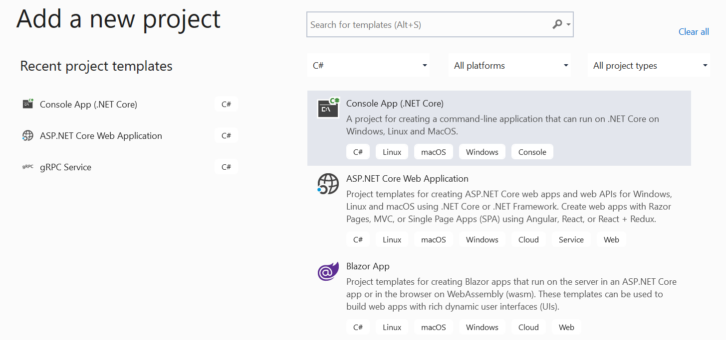
Build gRPC Client
gRPC Client could be anything from a simple Console Application to another Web Application
Notes:
Now that the gRPC service has been created, the next thing you need to do is implement a gRPC client to consume the service.

Slide 19
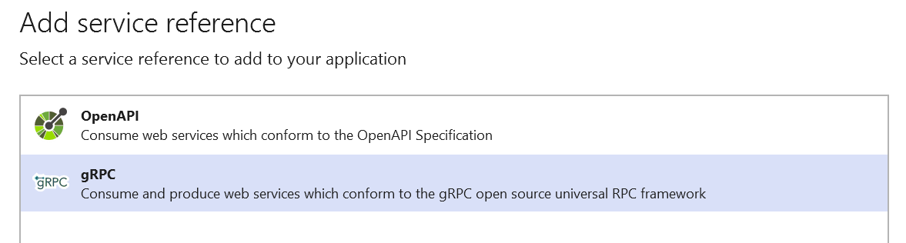
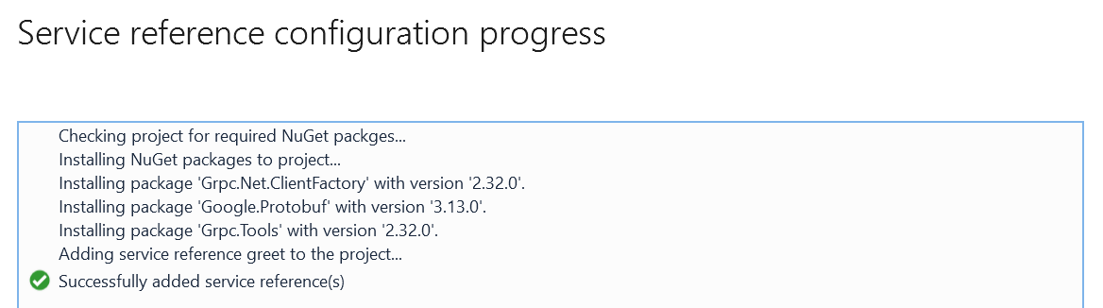
Build gRPC Client

Slide 20
Build gRPC Client
static async Task Main(string[] args)
{
var data = new HelloRequest { Name = "DEV Cafe" };
using var grpcChannel = GrpcChannel.ForAddress("https://localhost:5001");
var client = new Greeter.GreeterClient(grpcChannel);
var response = await client.SayHelloAsync(data);
Console.WriteLine(response.Message);
Console.ReadKey();
}
Create a new gRPC Channel that enables server communication.
Creates request object
Creates client for gRPC channel
Call RPC method via client

Slide 21

Demo
Create gRPC service using template
Create simple gRPC Client
Call service

Slide 22

REST vs gRPC
JSON
HTTP/1.1
Request/Response
Serialization
Protobuf
HTTP/2
Streaming
Strong Typing
Notes:
Remote Procedure Calls
Contract first (proto file)
Contract is designed for humans
Hides remoting complexity
HTTP APIs
Content first (URLs, HTTP method, JSON)
Content is designed for humans
Emphasizes HTTP

Slide 23
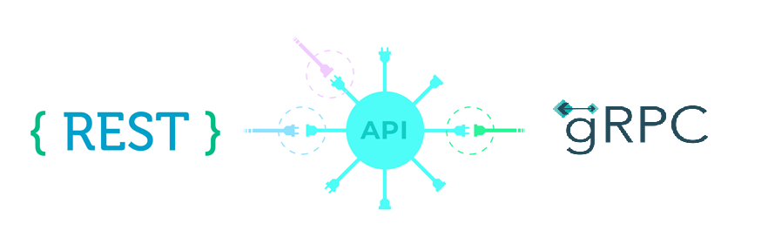
Frequently Asked Questions
Is gRPC faster than REST API?
Thanks to the added advantage of using Protocol Buffers and HTTP/2 , gRPCs are roughly around 7 to 10 times faster than an average WebAPI.

Slide 24
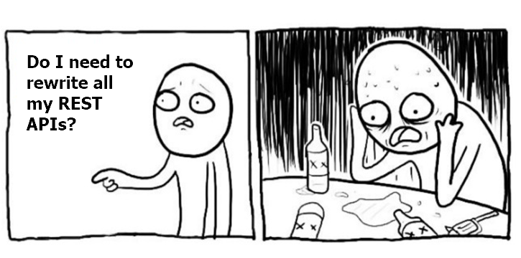
And now …

Slide 25
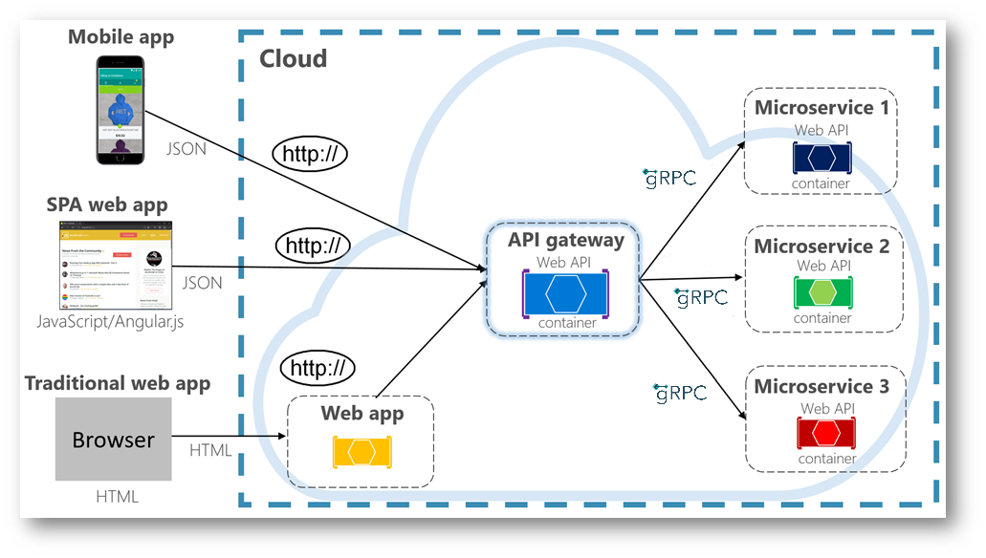
Hybrid gRPC and REST architectures

Slide 26

When consider gRPC?
For high performance microservices
If regular HTTP is slow
If strict contract is desired
For interoperability of different platforms
For simple message based duplex streaming

Slide 27

gRPC cons?
Not human readable, more complex
Limited debugging tooling (for now)
Less supported than regular HTTP+JSON
Requires HTTP /2
Browser support is limited

Slide 28



gRPC & .NET 5
WCF

Slide 29


What’s new in .NET 5
gRPC-Web browser support
gRPC-Web server middleware
gRPC-Web Blazor client
New gRPC hosts on Windows
HTTP.sys
IIS

Slide 30
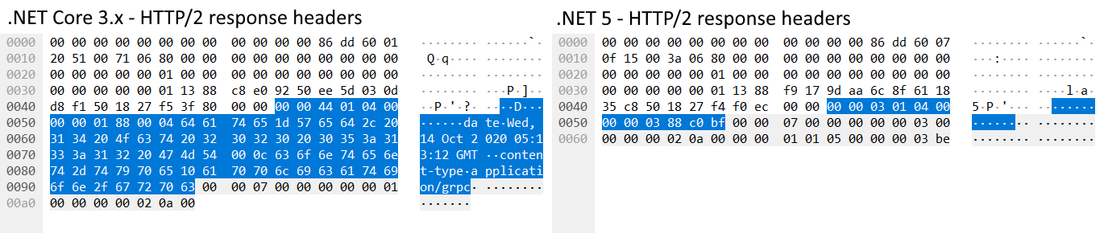
.NET 5 Performance Improvements
HTTP/2 client and server performance
Hpack header compression in Kestrel
Keep alive pings
Protobuf serializer support for modern .NET IO types
Additional transports (named pipes/unix domain sockets)
Notes:
Prior to .NET 5, Kestrel supported reading HPack compressed headers in requests, but it didn’t compress response headers. The obvious advantage of response header compression is less network usage, but there are performance benefits as well. It’s faster to write a couple of bits for a compressed header than it is to encode and write the header’s full name and value as bytes.
The biggest improvement to Google.Protobuf is support for modern .NET IO types: Span<T>, ReadOnlySequence<T> and IBufferWriter<T>. These types allow gRPC messages to be serialized directly using buffers exposed by Kestrel.

Slide 31
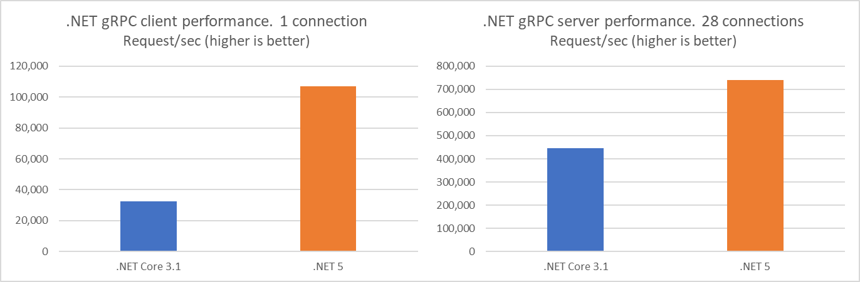
.NET 5 gRPC Improvement
60% improvement in gRPC server RPS and 230% improvement in gRPC client RPS

Slide 32
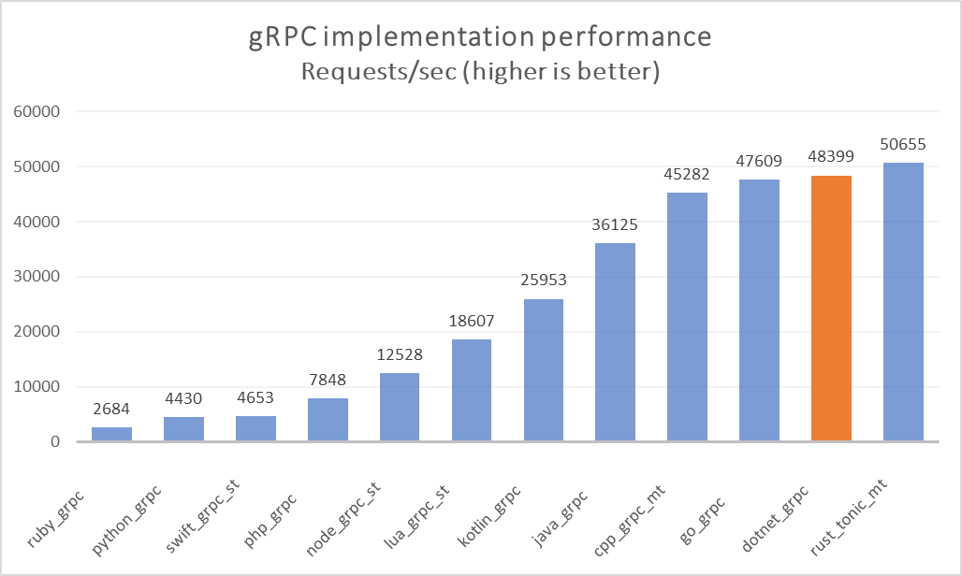
.NET 5 gRPC Performance
https://github.com/LesnyRumcajs/grpc_bench
Notes:
In a community run benchmark of different gRPC server implementations, .NET gets the highest requests per second after Rust, and is just ahead of C++ and Go.

Slide 33
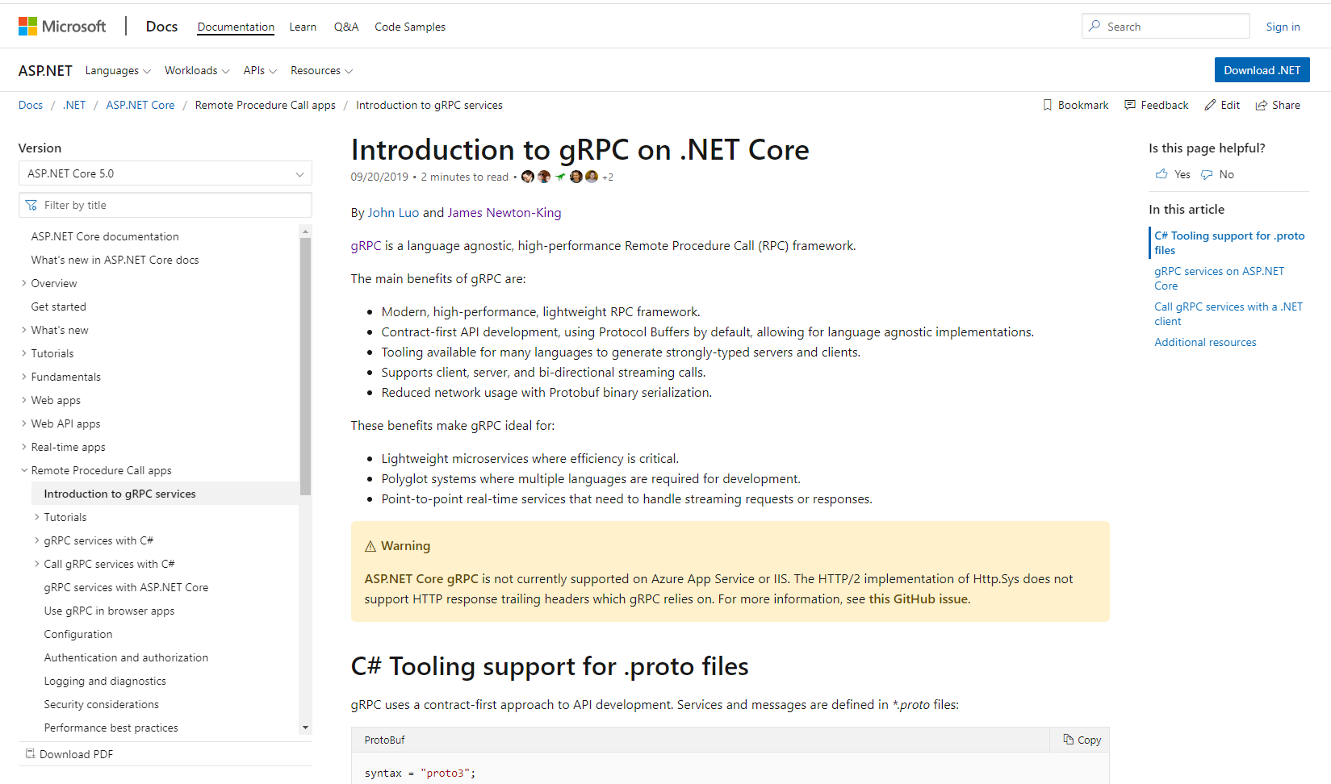
Resources – Documentation
Intro tutorial
Creating gRPC services
Call gRPC services
Create Protobuf messages
Versioning gRPC services
Using gRPC in browser apps
Create JSON Web APIs from gRPC
Performance best practices
And more
https://aka.ms/grpcdocs

Slide 34
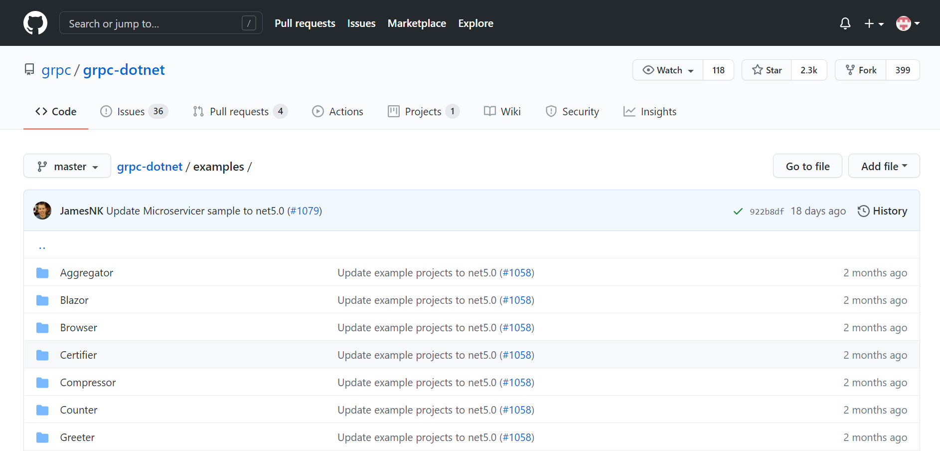
Resources – Samples
Hello world
Streaming
Certificate authentication
JWT authentication
OpenTelemetry
Unix domain sockets
Unit testing
Cancellation
And more
https://aka.ms/grpcexamples

Slide 35


Thanks for joining !
https://www.facebook.com/devcafevn

